Slide 1
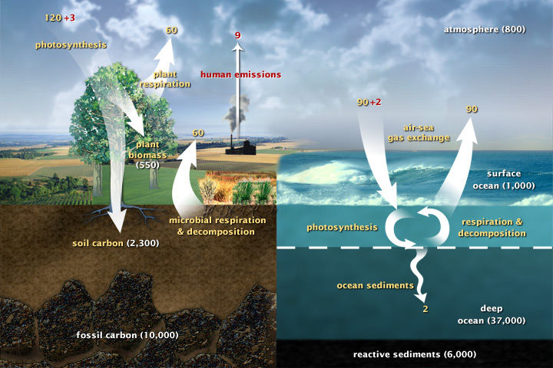
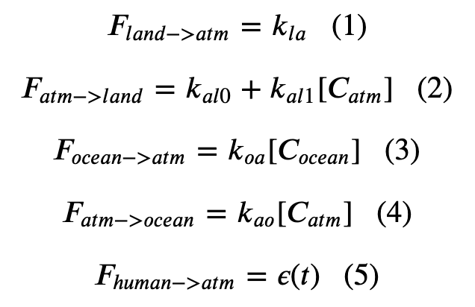
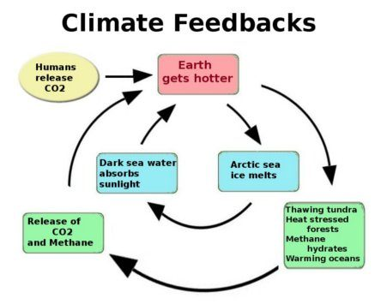
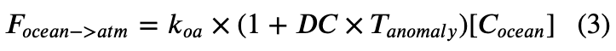
Summary of climate capabilities in Cambio 1-4
Cambio 1.0
Our five basic equations
Cambio 2.0
Added Henry’s effect
Cambio 3.0
Included ice-albedo feedback
Cambio 4.0
Includes terrestrial $CO_{2}$ fertilization feedback

Slide 2
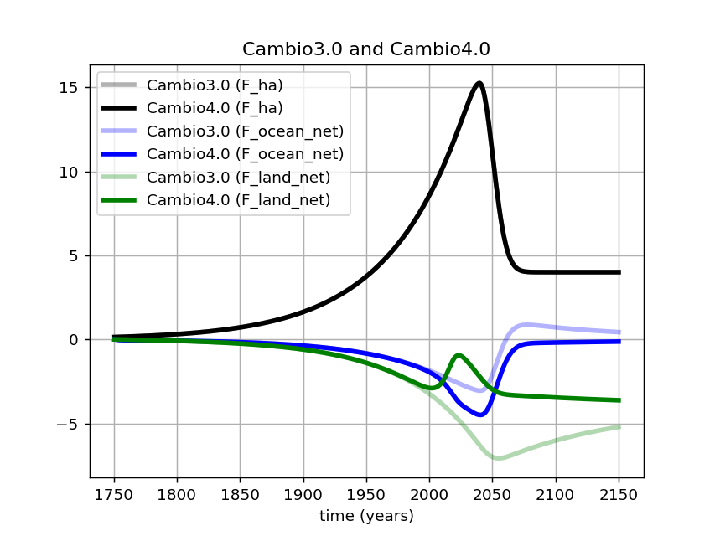
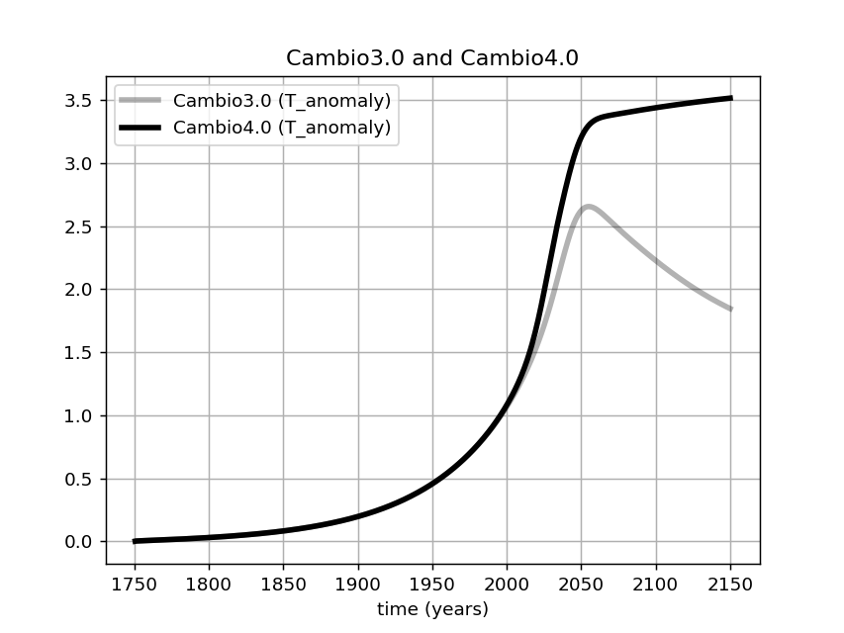
What can we learn from Cambio 4.0?
CO₂ feedback impairment makes a big difference in the maximum temperature anomaly (here, +0.75 degrees C and still rising).

Slide 3
What can we learn from Cambio 4.0?
CO₂ feedback impairment makes a big difference in the maximum temperature anomaly (here, +0.75 degrees C and still rising).
Also a big increase in when peak temperature will occur (here, from 2050 to 2150).

Slide 4
What can we learn from Cambio 4.0?
CO₂ feedback impairment makes a big difference in the maximum temperature anomaly (here, +0.75 degrees C and still rising).
Also a big increase in when peak temperature will occur (here, from 2050 to 2150).
Also, we can see that oceans are increasing their absorption of CO₂ in compensation for the impairment in terrestrial CO₂ fertilization.

Slide 5
Thoughts on these?
How might indigenous perspectives inform the task of modeling Earth’s climate?
The interview of Wilson Justin, about indigenous perspectives on climate change in the Arctic
The videorecording of the talk given by Shandin Pete, UBCV, Indigenous Perspectives on Data, Evidence, and Uncertainty in Science

